Slide 1
Emergency Calc
Developers: Dylan Engle, Eric Bunch, Weston Abner

Slide 2
Requirements
Emergency calc is being designed as a backup for STEM students that may have forgotten their scientific calculator, but has their laptop with them.
The front page will look like a generic graphing calculator.
Will be able to expand for more functionality
Each feature in the website will be split into different applications

Slide 3
Technology
HTML5
CSS
Typescript
Javescript
VSCode
Docker

Slide 4
Requirements – Front-end
Large Risk: Canvas for graphing application
Canvas to allow user to see a graph from inputted functions
Text box for inputting equations
Widget button that can expand to offer the user more functionality
File Menu

Slide 5
Requirements- Back-end
All backend applications will be written in typescript
Application for each button
File saver application
Image exporter application
Large Risk: Docker will be used for running the server

Slide 6
Requirements- File Saver
Ability to save calculations to a .txt
Load functionality to pull calculations from a .txt
Saving graphing functions will be saved into a separate .txt file from calculations
Load up the functions from the graph in order to see a premade graph

Slide 7
Requirements- Image Exporter
Large Risk
Ability to export the graph
UI will appear to ask the user for save location
Will display a message to the user that their graph has been saved
Option to save as a .png or .jpg

Slide 8
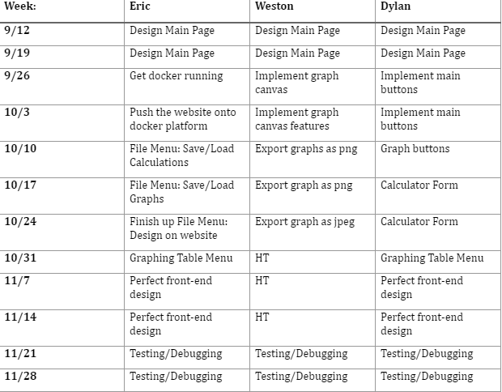
Timeline
Tentative Schedule
Note: HT = Helping teammates

